Slide 1
Senior project final presentation, fall 2015 Dynamic Mathematics Principles
Team: Andres Cubas
Mentor: Mario Eraso
Instructor: Masoud Sadjadi
School of Computing and information Sciences
Florida International University

Slide 2
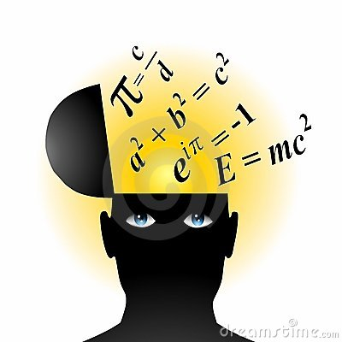
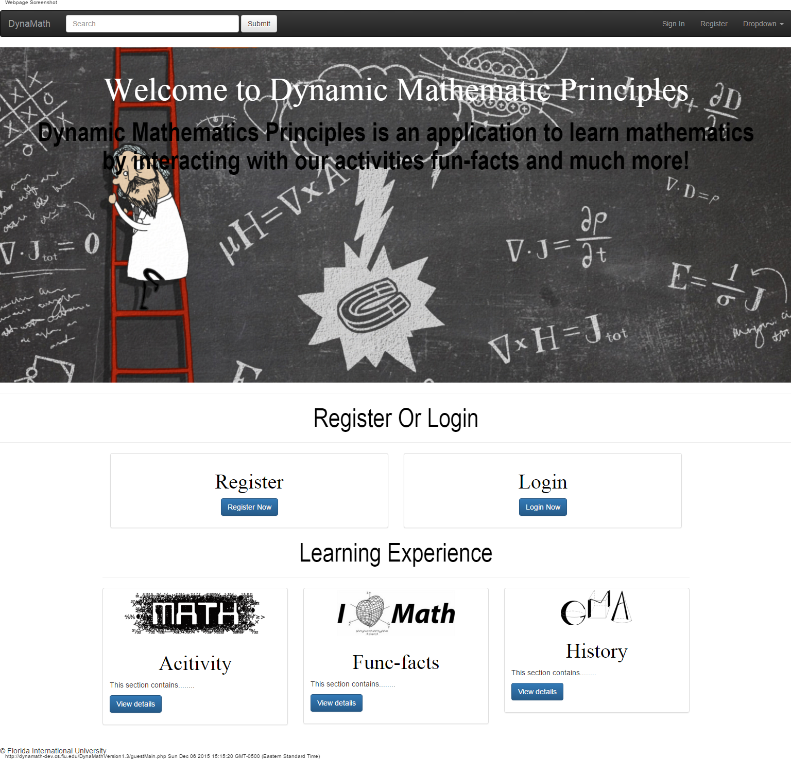
Problem Definition
The discipline of Mathematics presents challenges
to different learners. Our goal is to create a website where users can interact with our system to learn mathematical concepts.

Slide 3
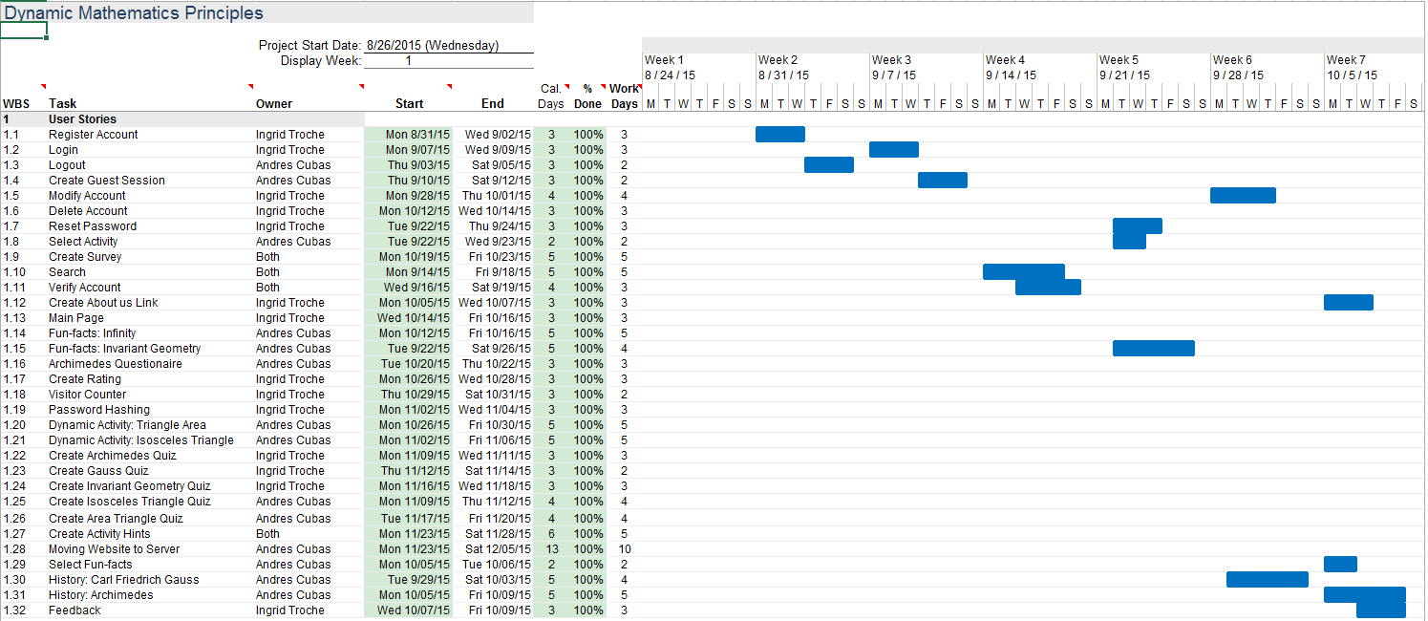
Project Management

Slide 4
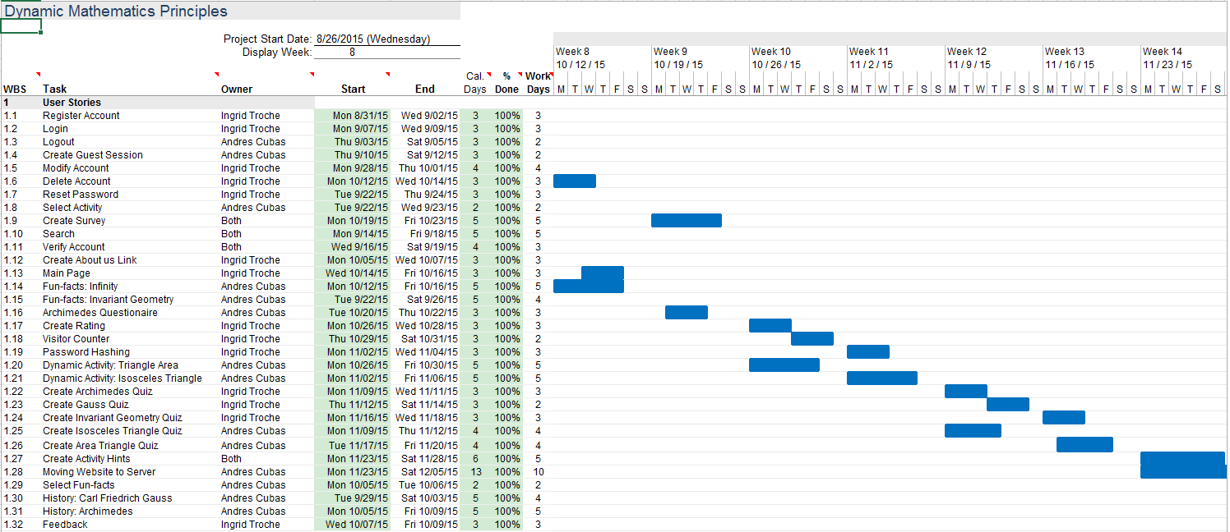
Project Management

Slide 5
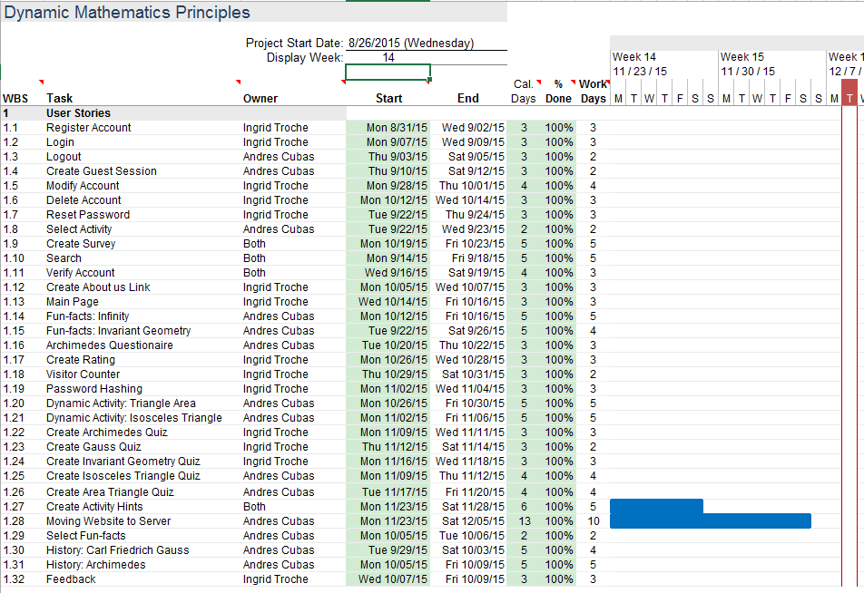
Project Management

Slide 6
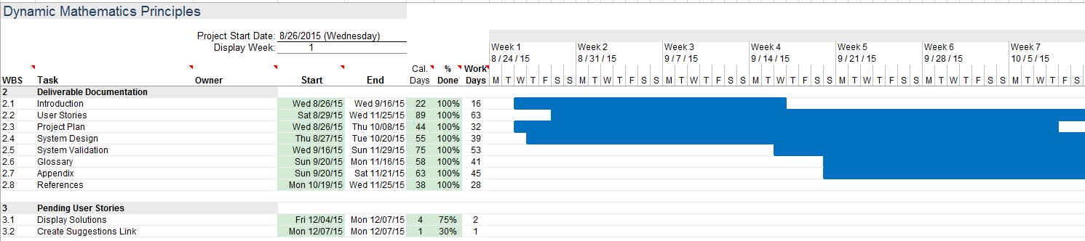
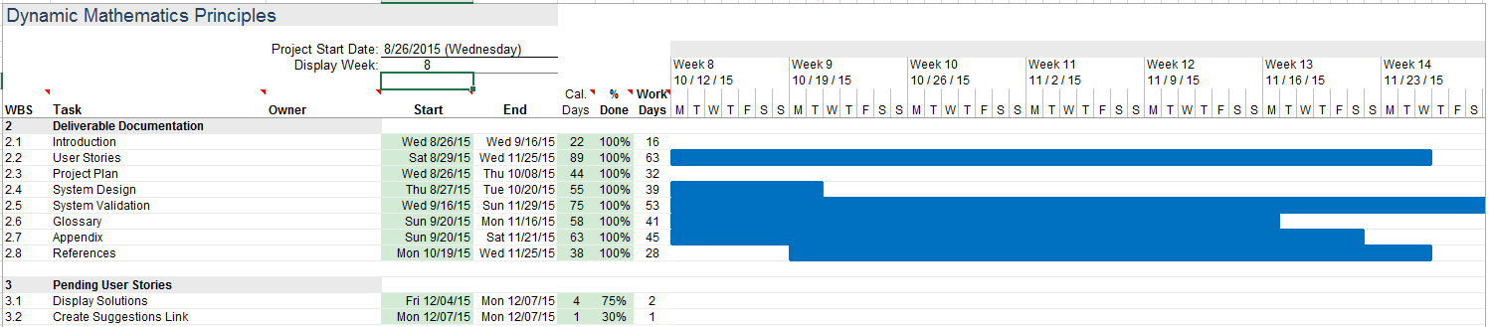
Project Management

Slide 7
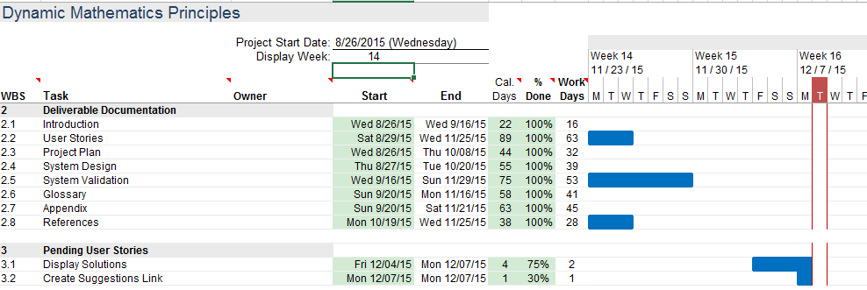
Project Management

Slide 8
User Stories
The system shall…
Allow users to register an account
Allow users to login
Allow users to logout
Allow users to modify account
Allow users to delete account
Allow users to send feedback
Allow users to rate activity
Allow users to view About Us page
Allow users to interact with history page

Slide 9
User Stories
Allow users to answer surveys
Allow users to view hints related to activities
Allow users to interact with the activities
Allow users to take quiz related to the activity

Slide 10
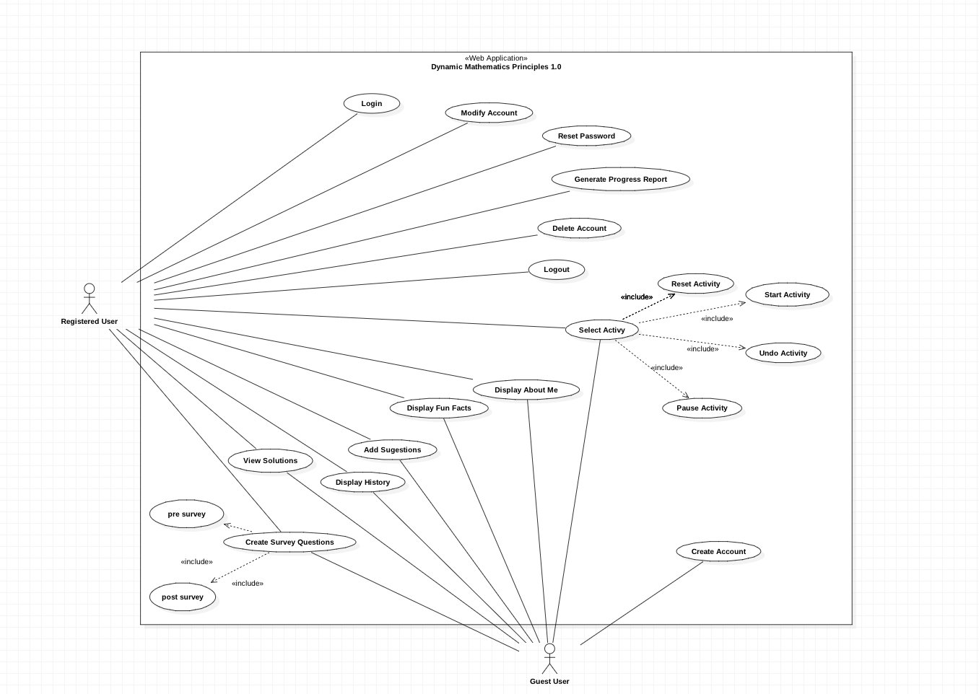
UML Use Case Model

Slide 11
USER STORY
Allow user to select activity– card#754
USER STORY DESCRIPTION: As a user, I would like to learn about the activities
ACTORS:
User
PRE-CONDITIONS:
User is logged in
User clicks on activity section
User interacts with the activity
DESCRIPTION:
Use case begins when user clicks on activities
The system responds displaying activities to the user
User case ends when the user successfully complete an activity

Slide 12
USER STORY
Allow user to select fun-facts– card#755
USER STORY DESCRIPTION: As a user, I would like to learn about the fun-facts
ACTORS:
User
PRE-CONDITIONS:
User is logged in
User clicks on the fun-fact section
User interacts with the fun-fact page
DESCRIPTION:
Use case begins when user clicks on activities
The system responds displaying activities to the user
User case ends when the user successfully complete an activity

Slide 13
USER STORY
Allow user to select History section– card#756
USER STORY DESCRIPTION: As a user, I would like to learn about some history about famous mathematicians
ACTORS:
User
PRE-CONDITIONS:
User is logged in
User clicks on the history section
User views the information displayed on the page
DESCRIPTION:
Use case begins when user clicks on history page
The system responds displaying history page to the user
User case ends when the user successfully finish reading the information

Slide 14
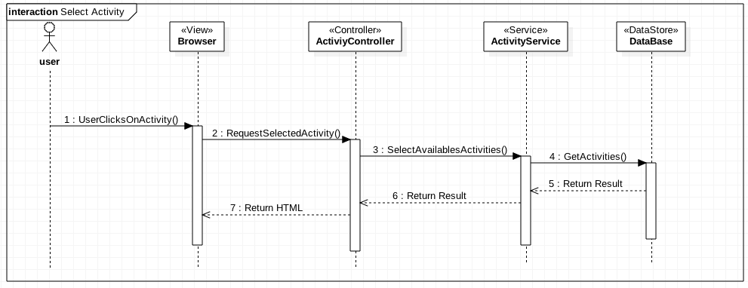
Sequence Diagrams

Slide 15
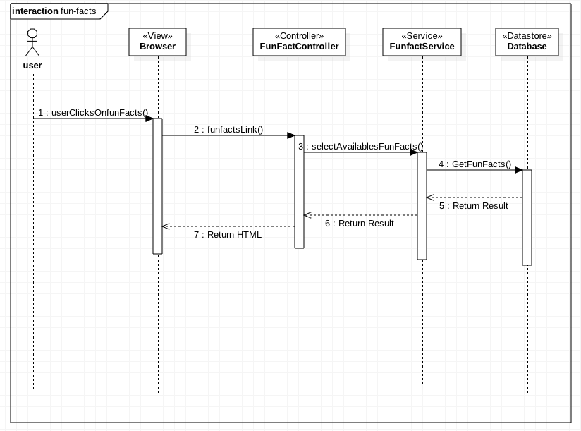
Sequence Diagram

Slide 16
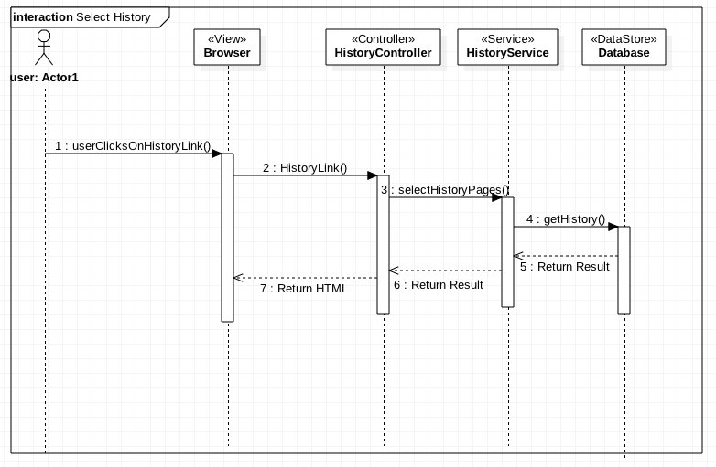
Sequence Diagram

Slide 17
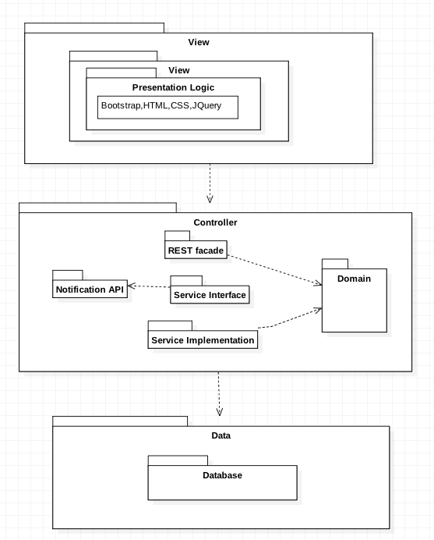
System Design

Slide 18
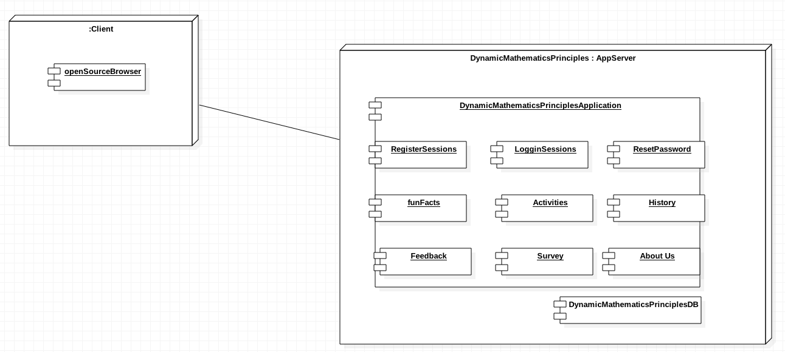
System Deployment

Slide 19
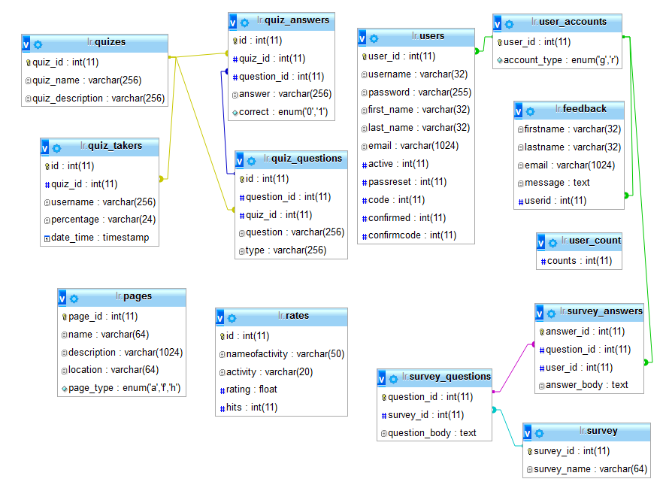
Data Design

Slide 20
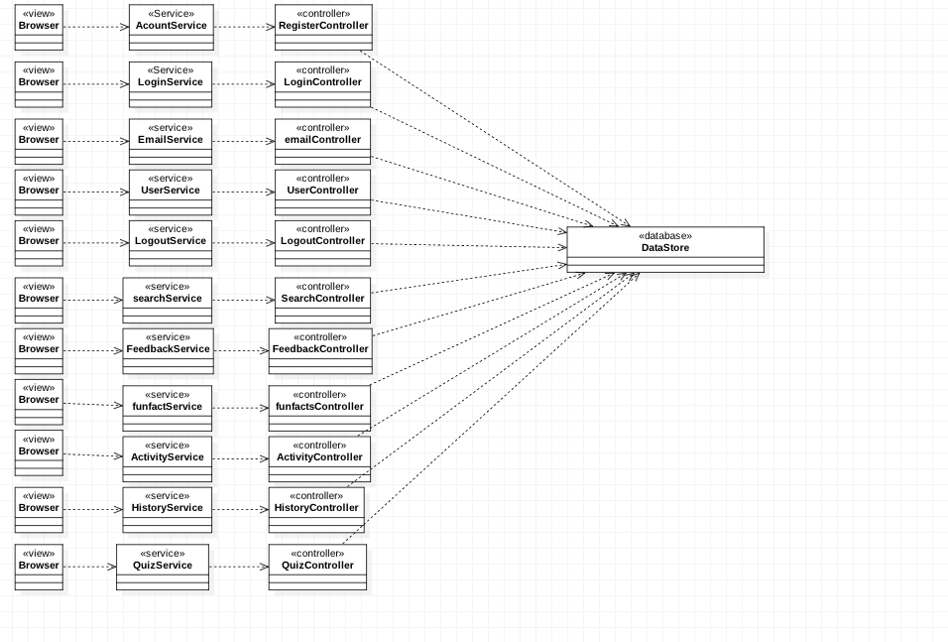
Minimal Class Diagram

Slide 21
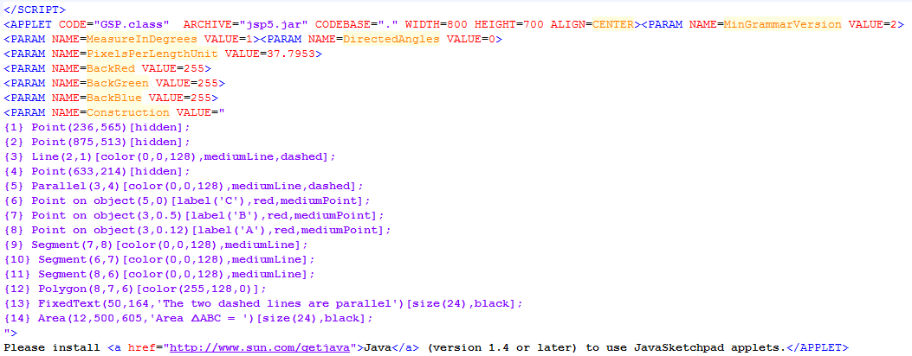
Algorithm for “Activity”

Slide 22
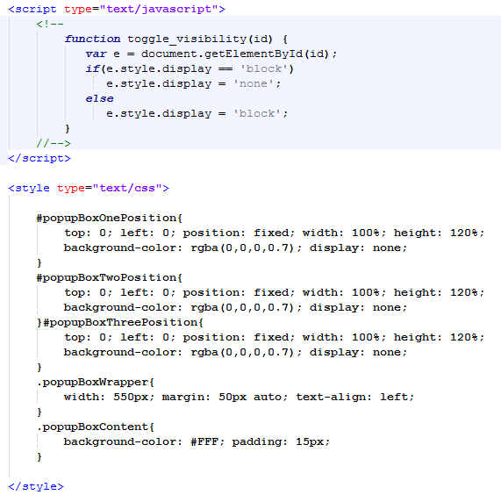
Algorithm for “Activity”

Slide 23
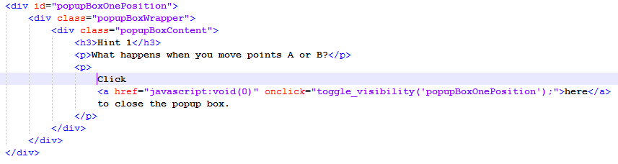
Algorithm for “Activity”

Slide 24
Validate that user can interact with activity
Test Case ID | DMP_TEST_ACTIVITY_SUNNY_01
Purpose | To validate user can take an activity
Preconditions | The website is running and there is internet connection
Inputs | The user clicks on the activity page. On the activity page, the different activities are displayed, the user clicks on the activity he/she wishes to solve
Expected output | The user is able to interact with the activity and successfully view hints and take quiz for the related activity

Slide 25
Validate that user can interact with activity
Test Case ID | DMP_TEST_ACTIVITY_RAINNY_01
Purpose | To validate user can take an activity
Preconditions | The website is running and there is internet connection
Inputs | The user clicks on the activity page. On the activity page, the different activities are displayed, the user clicks on the activity he/she wishes to solve
Expected Output | The user is not able to interact with the activity or to view hints/quiz for the related activity

Slide 26
Thank you!
Questions?

